Slide 1

Car Market Trends Analysis with Car Dekho
AICTE STU ID : STU677e95adc89d41736349101
Shahina Naaz Khan

Slide 2

PROBLEM STATEMENT
Pricing a used car is guesswork without data
Buyers and sellers on used-car marketplaces struggle to agree on a fair resale price. A car's value depends on many interacting factors — its age, original price, mileage, fuel type, and ownership history — but that relationship is rarely obvious from a quick look at a listing.
Without a structured way to explore this data, pricing decisions rely on intuition, leading to overpriced cars that sit unsold and underpriced cars that shortchange sellers.

Slide 3
WHERE THE GUESSWORK SHOWS UP
Age vs. price
How much does each year of age erode resale value?
Depreciation gap
How far does selling price fall from the original showroom price?
Fuel & transmission mix
Do Petrol, Diesel, or CNG cars command different prices?
Usage wear
Does kilometers driven meaningfully move the price?

Slide 4
Project Description
An exploratory data analysis of the Car Dekho listings
The project loads a real used-car dataset (car_data.csv) into pandas and walks through a structured EDA workflow — profiling the data, checking its quality, and visualizing the patterns that drive resale price.
1
2
3
4
Load & Inspect
Visualize Patterns
Profile the Data
Check Data Quality
Plot Car_Name frequency and Fuel_Type distribution with seaborn / matplotlib (countplot, bar, pie).
Read the CSV with pandas; preview the first and last rows with head() / tail().
Use describe() and info() to check data types, ranges, and distribution of each column.
Run isnull().sum() to confirm the dataset has zero missing values across all 9 columns.

Slide 5

WHO ARE THE END USERS?
Used-Car Buyers
Individual Sellers
Dealership Analysts
Data Science Learners
Compare a listed car's price against real market patterns before making an offer.
Benchmark an asking price using comparable cars' year, mileage, and fuel type.
Spot pricing trends across inventory — which models, fuel types, and ages move fastest.
A worked example of an EDA workflow: load, profile, clean-check, and visualize a real dataset.

Slide 6

Technology Used
A standard Python data-science stack
1
2
3
Python 3
pandas
NumPy
Core language for the whole notebook.
Loads car_data.csv; profiling via head(), describe(), info(), isnull().
Underlying numerical array support for pandas.
4
5
6
Matplotlib
Seaborn
Google Colab
Base plotting library — pie chart and bar chart of Fuel_Type.
Statistical visualization — countplot of Car_Name frequency.
Notebook execution environment; file upload / Drive-mount for the CSV.

Slide 7
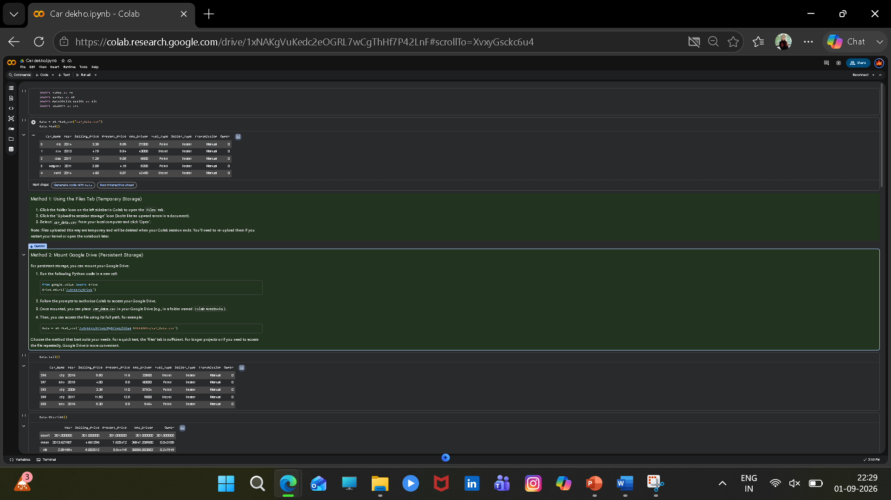
RESULTS

Slide 8
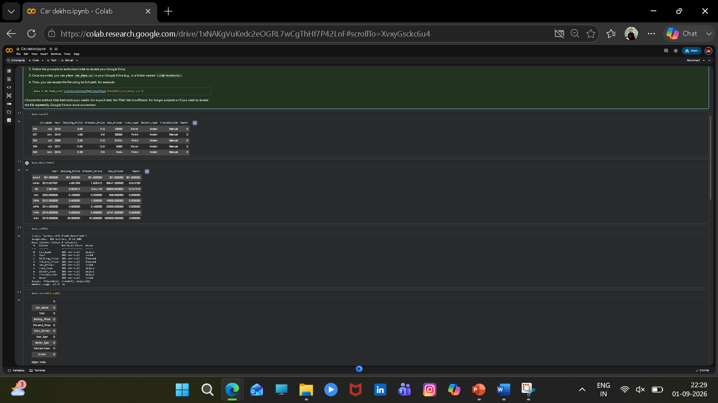

Slide 9
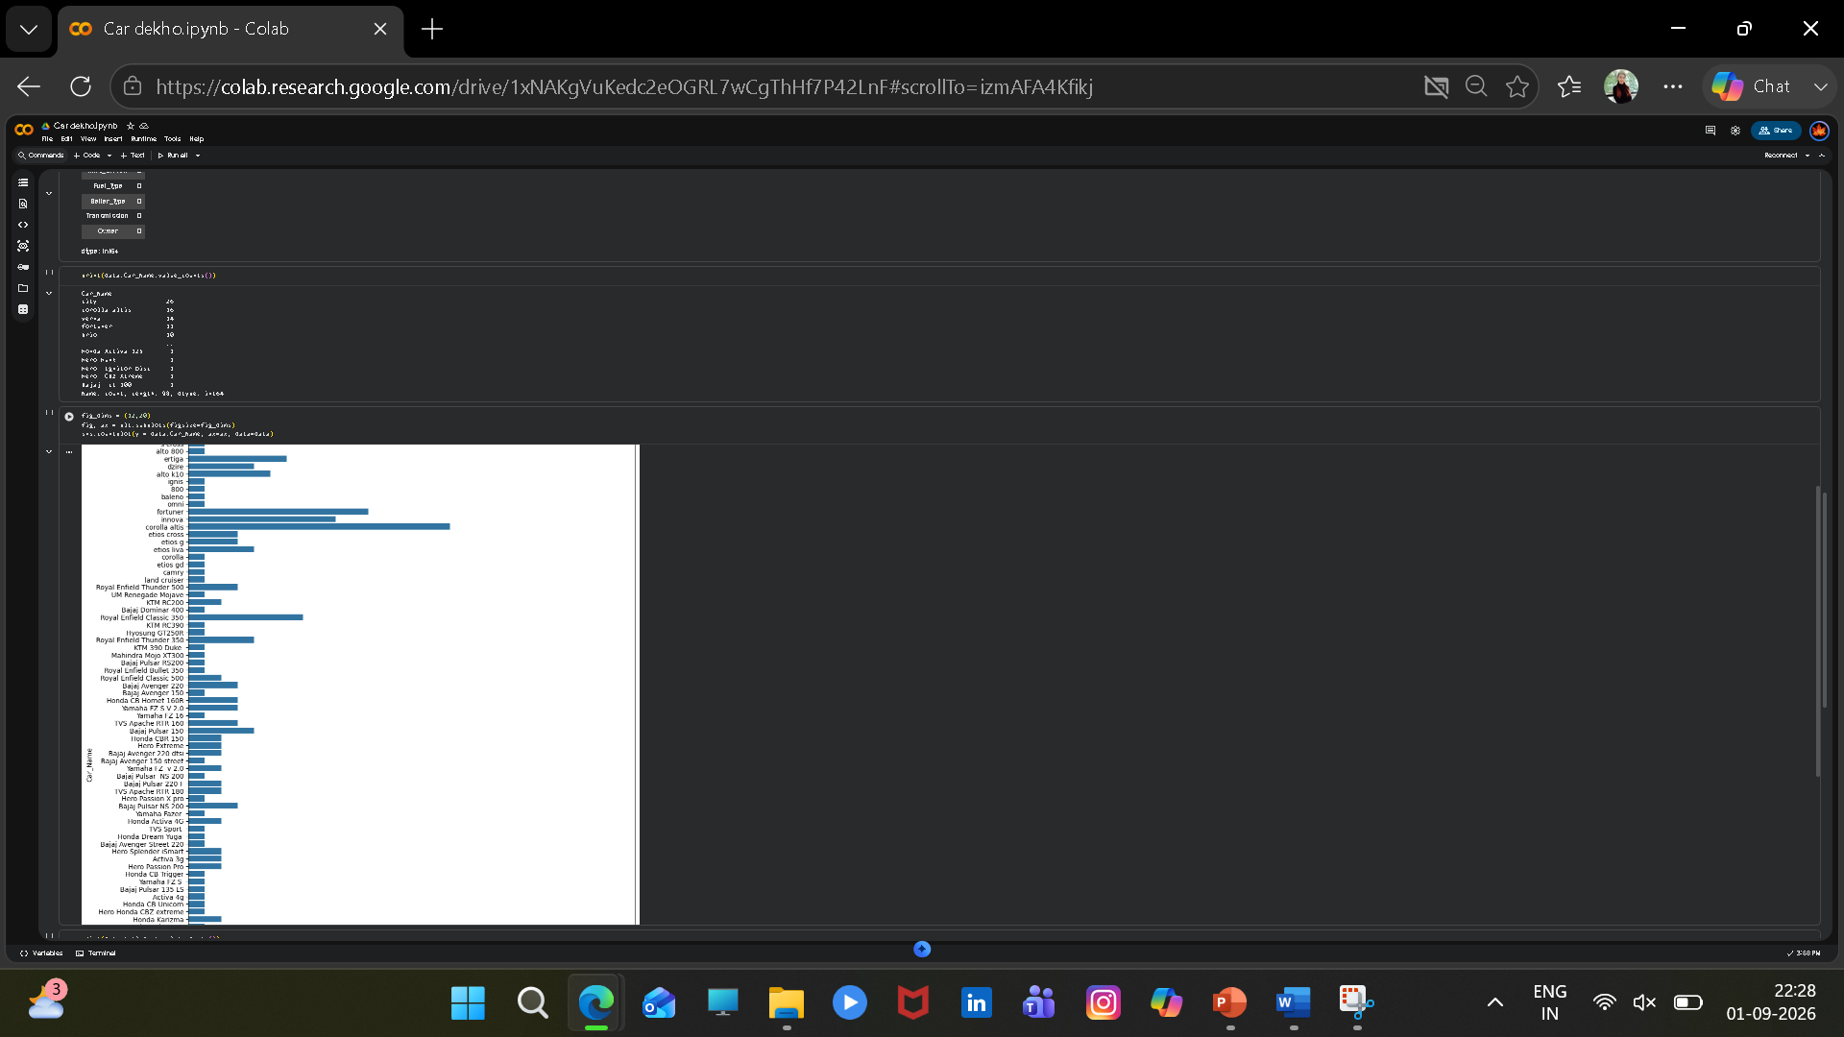

Slide 10
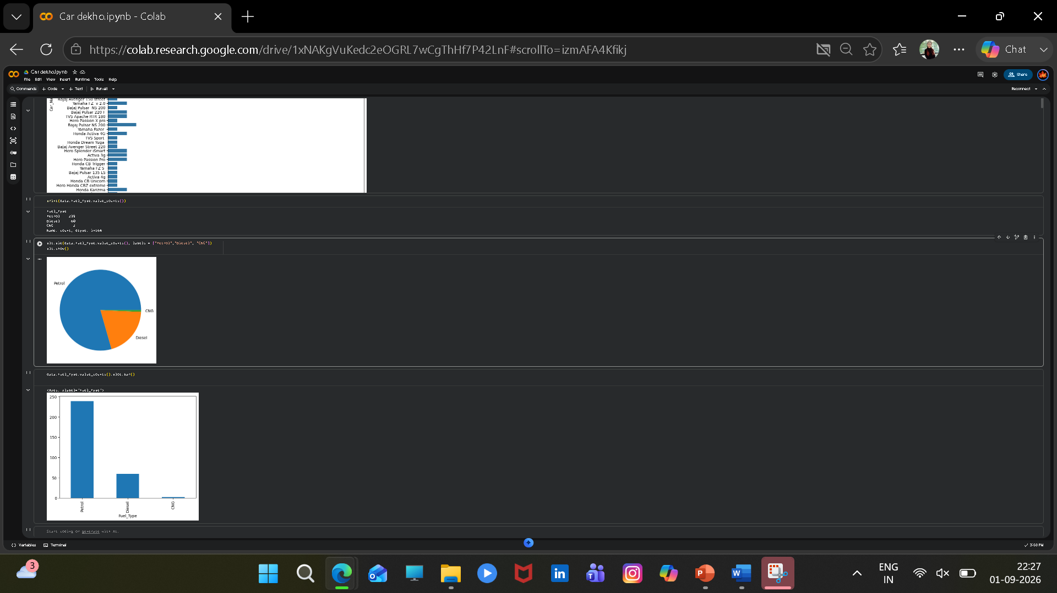

Slide 11
Thank you
.
.

